Slide 1
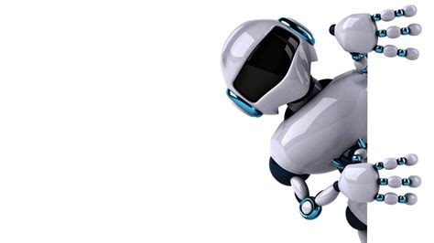
Alzheimer Disease Classification through Based on Convolutional Neural Network

Slide 2
TOC
Project Main idea
Bonus tip
Introduction
structure of Alzheimer Disease System
the Dataset employed
Details of the algorithm
Team
plots

Slide 3

Project Main idea
Alzheimer’s disease (AD) is the most generally known neurodegenerative disorder, leading to a steady deterioration in cognitiveability. Deep learning models have shown outstanding performance in the diagnosis of AD, and these models do not need any handcrafted feature extraction over conventional machine learning algorithms. Since the 2012 AlexNet accomplishment, the convolutional neural network (CNN) has been progressively utilized by the medical community to assist practitioners to earlydiagnose AD

Slide 4

Bonus Tips

Slide 5
Bonus Tips
First thing we try so hard to get this
The first try the data was un-balanced and we used 10 epoch we get 93.58%.
The second try the data was un-balanced and we used 20 epoch we get 96.78%.
The last try the data was balanced and we used 23 epoch we get 97.39%.

Slide 6
Introduction

Slide 7
Introduction
Alzheimer’s disease (AD), the most common form of dementia,is a major challenge for healthcare in the twenty-first century. Anestimated 5.5 million people aged 65 and older are living with AD,and AD is the sixth-leading cause of death in the United States.
The global cost of managing AD, including medical, socialwelfare, and salary loss to the patients’ families, was $277 billion in 2018 in the United States, heavily impacting the overall economy and stressing the U.S. health care system (Alzheimer’s Association, 2018). AD is an irreversible, progressive brain disorder marked by a decline in cognitive functioning with no validated disease modifying treatment (De strooper and Karran,2016.

Slide 8
Introduction
Thus, a great deal of effort has been made to develop strategies for early detection, especially at pre-symptomatic stages in order to slow or prevent disease progression (Galvin, 2017; Schelke et al., 2018).
In particular, advanced neuroimaging techniques, such as magnetic resonance imaging (MRI) and positron emission tomography (PET), have been developed and used to identify AD-related structural and molecularn biomarkers (Veitch et al., 2019).

Slide 9
Structure of Alzheimer Disease System

Slide 10
Structure of Alzheimer Disease System
Load Data Phase
Normalization Phase
Evaluation and prediction Phase
Preprocessing Phase
Training Phase
Testing Phase
2
4
6
1
3
5

Slide 11
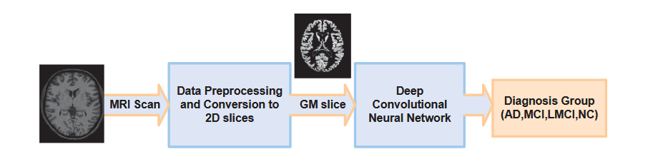
Structure of Alzheimer Disease System

Slide 12

Preprocessing Phase
02
Deep learning approaches require massive amounts of data to achieve the desired levels of performance accuracy. In currently limited neuroimaging data, the hybrid methods that combine traditional machine learning methods for diagnostic classification with deep learning approaches for feature extraction yielded better performance and can be a good alternative to handle the limited data.

Slide 13
Preprocessing Phase
02
Here, an auto-encoder (AE) was used to decode the original image values,making them similar to the original image, which it the included as input, thereby effectively utilizing the limited neuroimaging data. Although hybrid approaches have yielded relatively good results, they do not take full advantage of deep learning, which automatically extracts features from large amounts of neuroimaging data. The most commonly used deep learning method in computer vision studies is the CNN

Slide 14

Normalization Phase
03
Divide the data by 255.0

Slide 15
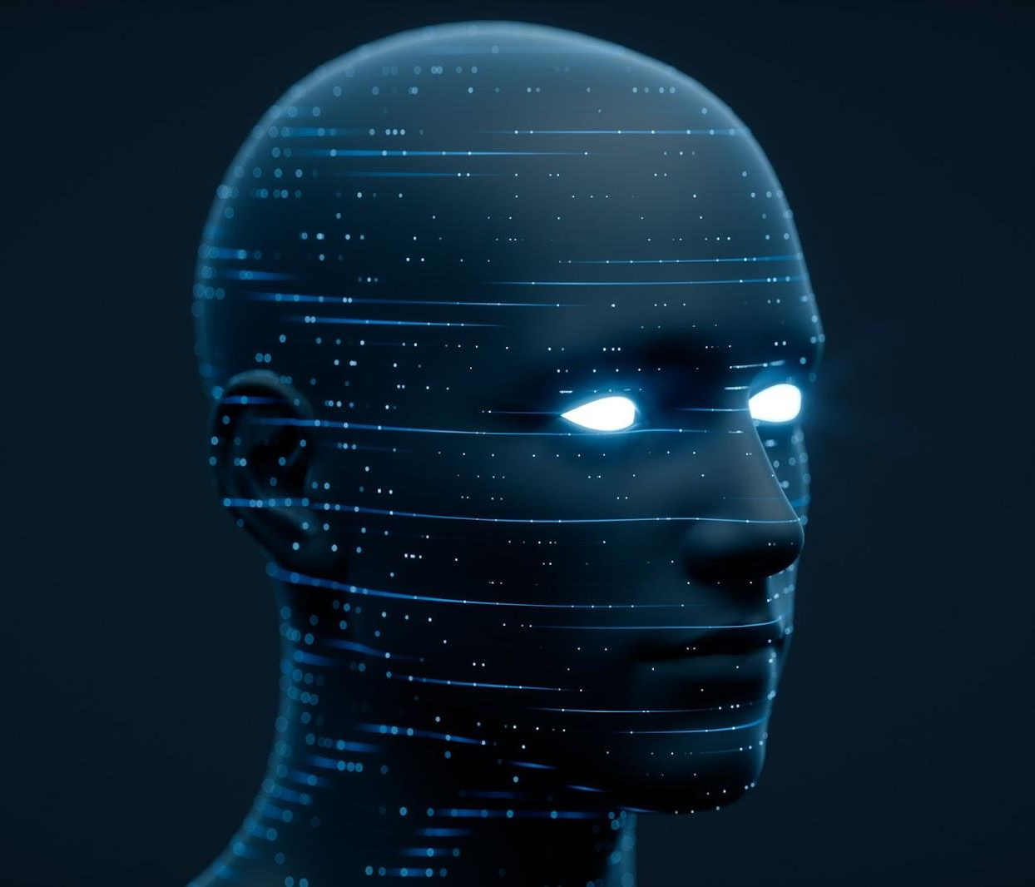
Training Phase
04
For the performance evaluation for Alzheimer’s classification, four transfer learning-based models were trained with the same architecture,
The first model was trained without using the feature of transfer learning and was provided with the images without augmentation. The second one was again trained without the feature of transfer learning but was provided with augmented MRIs. The next two models were used with the feature of transfer learning and were trained on only original MRIs and augmented MRIs, respectively.

Slide 16
Training Phase
04
Gray matter (GM) images, as shown in Figure 11, were provided to the models for training. Three views of these MRIs, i.e., axial, coronal, and sagittal, were considered for training the models and, in total, 6400 images from each category, i.e., AD, NC, MCI, and LMCI, were used. In two steps, the data were divided into training, validation, and testing Sets.

Slide 17
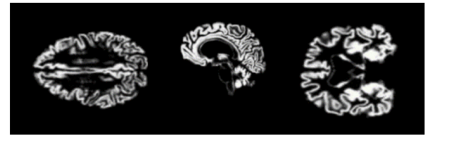
Training Phase
04
In the first step, 20% of the data were split and separated for testing.
The remain-ing 80% of the data were further divided into 60%training and 20% validation sets

Slide 18

Evaluation and prediction Phase
05
Evaluation is a process during development of the model to check whether the model is best fit for the given problem and corresponding data. Keras model provides a function, evaluate which does the evaluation of the model
Prediction is the final step and our expected outcome of the model generation. Keras provides a method, predict to get the prediction of the trained model.

Slide 19
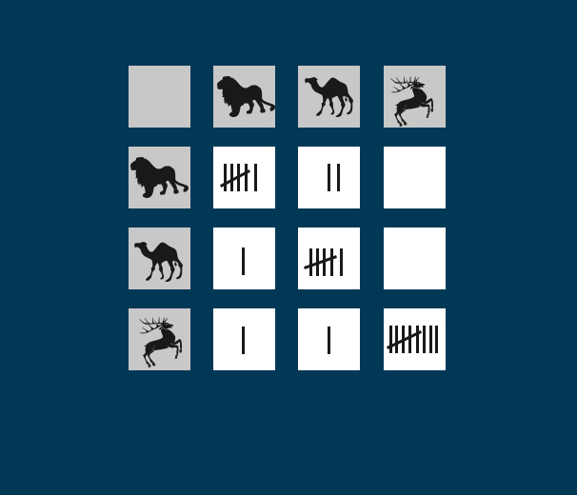
Testing Phase
06
A classification model assigns to each entity the outcome it considers to be the most appropriate. The outcome is the predicted value that is determined by the classification model.
The predicted value for the outcome can differ from the actual value of the outcome because a classification model is almost never perfect. The main reason for this is that the reality is much more complex than its representation in a mining model

Slide 20
The Dataset employed

Slide 21
The Dataset employed
The Data is collected from several websites/hospitals/public repositories.
The Dataset is consists of Preprocessed MRI (Magnetic Resonance Imaging) Images.
All the images are resized into 128 x 128 pixels.
The Dataset has four classes of images.
The Dataset is consists of total 6400 MRI images. Class - 1: Mild Demented (896 images) Class - 2: Moderate Demented (64 images) Class - 3: Non Demented (3200 images) Class - 4: Very Mild Demented (2240 images)
The link: https://www.kaggle.com/datasets/sachinkumar413/alzheimer-mri-dataset
Googlenet
98.88%
Res_Net 18
98.01%
Res_Net 150
98.04%
CNN
97.06%
The paper link;
https://www.ncbi.nlm.nih.gov/pmc/articles/PMC6710444/

Slide 22
Details of the algorithm

Slide 23
Convolutional Neural Network
A Convolutional Neural Network (CNN) is a type of deep learning algorithm that is particularly well-suited for image recognition and processing tasks. It is made up of multiple layers, including convolutional layers, pooling layers, and fully connected layers.
The convolutional layers are the key component of a CNN, where filters are applied to the input image to extract features such as edges, textures, and shapes. The output of the convolutional layers is then passed through pooling layers, which are used to down-sample the feature maps, reducing the spatial dimensions while retaining the most important information. The output of the pooling layers is then passed through one or more fully connected layers, which are used to make a prediction or classify the image.

Slide 24
Neural Network
a Neural network (NN) is considered a robust classification methodology that works correctly in non-linear or linear datasets. It had been employed not only for face recognition applications but also in diverse areas such as fingerprint recognition, voice recognition, iris recognition, Natural Language processing, etc. (Yousif & Sembokb2005; Yousif & Fekihal 2012).
he effectiveness of NN and its increased use could be due to its ability to work in a non-linear network (Boughrara et al., 2012).
Therefore, the feature extraction phase of face characteristics through using NN is more effective and efficient than using the linear karhun nen-loeve technique (Lawrence et al., 1997).

Slide 25
Neural Network
The first ANN technique utilized for face recognition is a single-layer adaptive network known as "WISARD" (Stonham et al., 1986).
The WISARD comprises a distinct network for each stored person. Constructing the NN structure is critical for making a successful face recognition system, and the model that should be applied depends on the intended application objectives (Stonham et al., 1986).
Commonly, Convolutional Neural Network (CNN), as well as Multi-layers Perception (MLP) structure, have been employed for the aim of face detection (Sung & Poggio,1995).
On the other hand, the Multi-Resolution Pyramid structure has been applied efficiently for face verification purposes.

Slide 26
References
Aderghal, K., Benois-Pineau, J., Afdel, K., and Catheline, G. (2017). “FuseMe:
classification of sMRI images by fusion of deep CNNs in 2D+ǫ projections,” in
Proceedings of the 15th International Workshop on Content-Based Multimedia
Indexing (New York, NY).
Alzheimer’s Association (2018). 2018 Alzheimer’s disease facts and figures.
Alzheimer’s Dementia 14, 367–429. doi: 10.1016/j.jalz.2018.02.001
Bengio, Y. (2009). Learning deep architectures for AI. Found. Trends Mach. Learn.
2, 1–127. doi: 10.1561/2200000006
Bengio, Y. (2013). “Deep learning of representations: looking forward,” in
International Conference on Statistical Language and Speech Processing
(Tarragona: Springer), 1–37.
Bengio, Y., Courville, A., and Vincent, P. (2013). Representation learning: a review
and new perspectives. IEEE Trans. Pattern Anal. Mach. Intell. 35, 1798–1828.
doi: 10.1109/TPAMI.2013.50
Bishop, C. M. (1995). Neural Networks for Pattern Recognition. New York, NY:
Oxford University Press.
Bottou, L. (2010). “Large-scale machine learning with stochastic gradient descent,”
in Proceedings of COMPSTAT’2010 (Paris: Springer), 177–186.
Boureau, Y.-L., Ponce, J., and Lecun, Y. (2010). “A theoretical analysis of
feature pooling in visual recognition,” in Proceedings of the 27th International
Conference on Machine Learning (ICML-10) (Haifa), 111–118.
Bush, W. S., and Moore, J. H. (2012). Genome-wide association studies. PLoS
Comput. Biol. 8:e1002822. doi: 10.1371/journal.pcbi.1002822
Cheng, D., and Liu, M. (2017). “CNNs based multi-modality classification for AD

Slide 27
References
[11]. Kaushal, A., & Raina, J. P. S. (2010). Face detection using neural network & Gabor wavelet transform. IJCST, 1(1).
[12]. Khan, M. Z., Harous, S., Hassan, S. U., Khan, M. U. G., Iqbal, R., & Mumtaz, S. (2019). Deep unified model for face
recognition based on convolution neural network and edge computing. IEEE Access, 7, pp 72622-72633.
[13]. Hasoon, F. N., Yousif, J. H., Hasson, N. N., & Ramli, A. R. (2011). Image Enhancement Using Nonlinear Filtering Based
Neural Network. Journal of Computing, 3(5), pp 171-176.
[14]. Hassin, A., & Abbood, D. (2021). Human–Ear Recognition Using Scale Invariant Feature Transform. Artificial Intelligence
& Robotics Development Journal, pp 1-12.
[15]. Lawrence, S., Giles, C. L., Tsoi, A. C., & Back, A. D. (1997). Face recognition: A convolutional neural-network approach.
IEEE transactions on neural networks, 8(1), pp 98-113.
[16]. Li, X., & Areibi, S. (2004, December). A hardware/software co-design approach for face recognition. In Proceedings. The
16th International Conference on Microelectronics, 2004. ICM 2004. (pp. 55-58). IEEE.
[17]. Lin-Lin Huang, et al (2003) “Face detection from cluttered images using a polynomial neural network”, Neurocomputing,
Vol.51, pp197 – 211.
[18]. Matsugu, M., Mori, K., Mitari, Y., & Kaneda, Y. (2003). Subject independent facial expression recognition with robust face
detection using a convolutional neural network. Neural Networks, 16(5-6), pp 555-559.
[19]. Ming, Y., Ruan, Q., Li, X., & Mu, M. (2010, October). Efficient Kernel discriminate spectral regression for 3D face
recognition. In IEEE 10th international conference on signal processing proceedings (pp. 662-665). IEEE.
[20]. Mohamed, A., Weng, Y., Jiang, J., & Ipson, S. (2008, July). Face detection based neural networks using robust skin color
segmentation. In 2008 5th International Multi-Conference on Systems, Signals and Devices (pp. 1-5). IEE

Slide 28
References
[21]. Norris, J. S. (1999). Face detection and recognition in office environments (Doctoral dissertation, Massachusetts Institute of
Technology).
[22]. Raheja, J. L., & Kumar, U. (2010). Human facial expression detection from detected in captured image using back propagation
neural network.
[23]. Rowley, H. A., Baluja, S., & Kanade, T. (1998, June). Rotation invariant neural network-based face detection. In Proceedings.
1998 IEEE Computer Society Conference on Computer Vision and Pattern Recognition (Cat. No. 98CB36231) (pp. 38-44).
IEEE.
[24]. Rowley, H., Baluja, S., & Kanade, T. (1999). Neural Network-Based Face Detection, Computer Vision and Pattern
Recognition. Neural Network-Based Face Detection, Pitts-burgh, Carnegie Mellon University, PhD thesis.
[25]. Sahoolizadeh et al. (2008) “Face Detection using Gabor Wavelets and Neural Networks”, World Academy of Science,
Engineering and Technology, Vol. 45, pp 552- 554.
[26]. Shaaban, H. (2021). Enhanced Region of Interest Extraction method for Finger Vein Images. Artificial Intelligence & Robotics
Development Journal, pp 13-25.
[27]. Saudagare, P. V., & Chaudhari, D. S. (2012). Facial expression recognition using neural network–An overview. International
Journal of Soft Computing and Engineering (IJSCE), 2(1), pp 224-227.
[28]. Shilbayeh, N., & Al-Qudah, G. (2008). Face detection system based on MLP neural network. Recent Advances in Neural
Networks, Fuzzy Systems & Evolutionary Computing, 3(8), pp 238-243.
[29]. Stonham, T. J. (1986). Practical face recognition and verification with WISARD. In Aspects of face processing (pp. 426-441).
Springer, Dordrecht.

Slide 29
Plots
Team

Slide 30
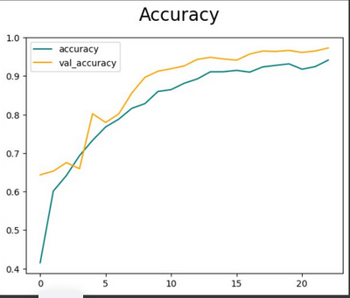
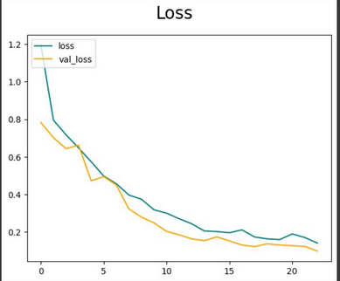
Accuracy
Loss

Slide 31
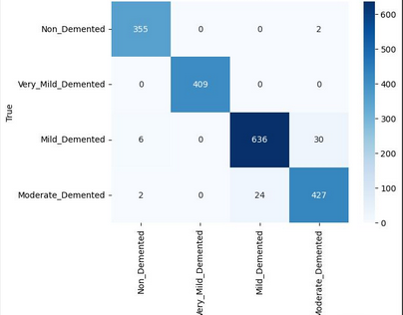
Confusion matrix
For testing

Slide 32
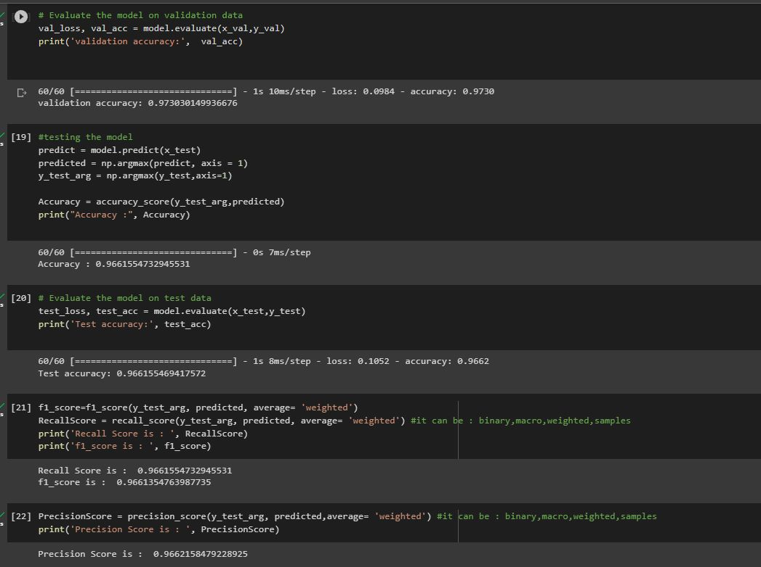
The validation accuracy;97.3
The testing accuracy;96.6
The recall;96.6
The f-1 score;96.6
The precision96.6

Slide 33
Development platform
Team

Slide 34
Tools: Anaconda, Jupiter Notebook.
Programming Languages: Python.
Python Libraries: pyodbc , matplotlib, io, os , PIL, NumPy, cv2, mtcnn , sklearn , tkinter , imageio , playsound ,keras.

Slide 35
Team
Team

Slide 36
Team member
01 | Abdel rahman Ali Mostafa
| 202000522
02 | Mohamed Abdel Moneim Mohamed
| 202000786
03 | Yousef Mohammed Abdulmohsen Ahmed
| 202001107
04 | Mariam Maher Zaki Ghaly
| 202000883
05 | Abdullah Sharif Hammad Mahmoud
| 202000547
06 | Omar Wael Sabry Hassan
| 202000614
07 | Iman Ahmed Abdo Ahmed Fouda
| 202000174

Slide 37
Thank you.

